Slide 1
How to Add Signature
in
Lotus Notes

Slide 2
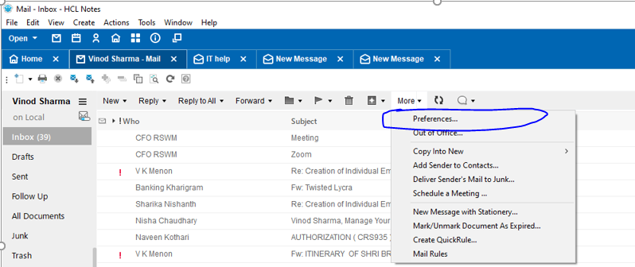
Step-1
Go to More → Click on Preferences…

Slide 3
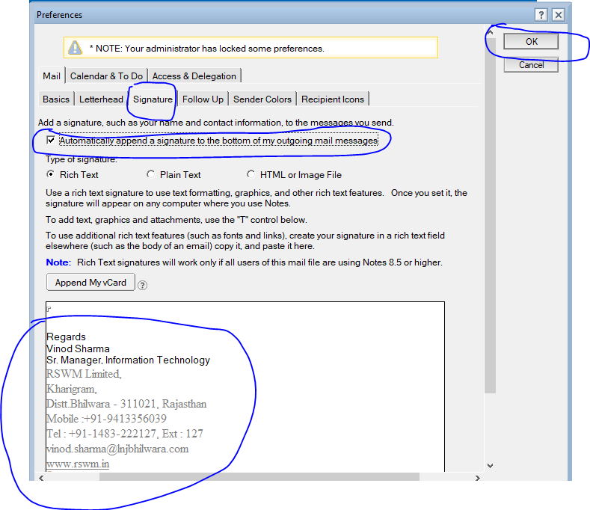
Step-2
Click on Signature
Type complete contact details in below given space
Check Mark on Automatically append a signature to the bottom of my outgoing mail messages
Click on OK button

Slide 4
Thanks

